Slide 1
9 to 1 GCSE reforms in England

Slide 2
Overview of the system: what is happening, when?

Slide 3
Notes:
GCSEs – c.5.5m GCSEs awarded each year
AS and A levels – c.2.2m awarded each year

Slide 4
When do these reforms affect GCSE students?
Level | Started course in 2015, first exams in 2017 | Started course in 2016, first exams in 2018 | Started course in 2017, first exams in 2019 | Start course in 2018, first exams in 2020
GCSE | English literature, English language and maths only. | English and maths plus… Art and design, biology, chemistry, citizenship studies, combined science, computer science, dance, drama, food preparation and nutrition, French, geography, German, classical Greek, history, Latin, music, physical education (including short course), physics, religious studies (including short course), and Spanish. | 2015 and 2016 subjects plus… Ancient history, Arabic, astronomy, Bengali, business, Chinese, classical civilisation, design and technology, economics, electronics, engineering, film studies, geology, Italian, Japanese, media studies, modern Greek, modern Hebrew, Panjabi, Polish, psychology, Russian, sociology, statistics, and Urdu. | All previous subjects plus… Gujarati, biblical Hebrew, Persian, Portuguese and Turkish.
Notes:
What is happening?
GCSEs are in the process of being reformed, taught and awarded as shown in the table above. The last phase of the reformed qualifications will be available in schools from September 2018.
Some GCSE subjects have not been reformed and will not be continuing. For a full list of these subjects please see here: https://www.gov.uk/government/publications/gcse-as-and-a-level-subjects-that-are-not-being-reformed
Exam certificates awarded in 2017, 2018 and 2019 may have a mixture of numbers and letters on them, depending on the mix of subjects the student has taken.

Slide 5
Reformed GCSEs
Content New and more challenging content
Structure All exams at the end of the course
Assessment Mainly by examination
Non-exam assessment only where necessary
Tiering Foundation and higher tier permitted only in maths, statistics, science and modern foreign languages
Grading New numbered scale (9 to 1 plus U), 9 is the highest
Notes:
Content – GCSEs have been reformed to make them more rigorous. They will still be suitable for a wide range of abilities but syllabuses will include more challenging, knowledge-based content. Assessments have been changed to reflect the full ability range to identify and reward the highest performers. Changes to the content vary by subject.
The Department for Education’s content for all new GCSE subjects is available here: https://www.gov.uk/government/collections/gcse-subject-content
Detailed specifications for accredited qualifications are available on awarding organisations’ websites. An up-to-date list of accredited subjects for first teaching in September 2018 is available here: https://www.gov.uk/government/publications/accreditation-of-gcses-and-a-levels-for-teaching-from-2018/gcse-and-a-level-subjects-accredited-to-be-taught-from-2018
Structure – The new 9 to 1 GCSEs will be linear with exams only at the end of the course. This means students will not sit modular-based assessments, which will allow more time for teaching. Previously GCSEs were designed to be modular which meant that students could retake individual modules throughout the course; although students haven’t been able to do this since 2014.
Assessment – The amount of 'coursework' in each subject varies. Coursework or non-exam assessment (NEA) will only be included where skills and knowledge cannot be assessed validly by exams. More information about how non-exam assessments have changed can be found here: https://www.gov.uk/government/publications/gcse-changes-a-summary/summary-of-changes-to-gcses-from-2015
Tiering – In the new 9 to 1 GCSEs, only maths, statistics, science, and all modern foreign language GCSEs such as French, German and Spanish will be tiered (where pupils either sit foundation or higher exams). Tiering has been removed from most GCSEs to ensure that where possible students are not limited from achieving higher grades and can access the full grade range. In foundation tiers, GCSE students will be able to achieve a maximum of grade 5. A student must enter for higher OR foundation tier in any of the tiered individual subjects for the whole qualification.
Grading – see slide 6
How this affects students – Ofqual ensure that it is no more difficult to get a particular grade from one year to the next in any GCSE. To ensure that cohorts of students taking the new 9 to 1 GCSEs are not disadvantaged, Ofqual will use a statistical method called comparable outcomes, so that if the ability profile remains broadly the same:
the same proportion of students achieve a grade 1 and above as would have achieved a grade G and above last year
the same proportion of students achieve a grade 4 and above as would have achieved a grade C and above last year, and
the same proportion of students will achieve a grade 7 and above as would have achieved a grade A and above last year.
This means, in general, a student who for example got a grade 7 in English or maths in 2017, could expect to get a grade 7 in 2018. And similarly, a student who would have expected to get a grade A in a previous version of any GCSE in which new exams are being taken for the first time this year, could expect to get a grade 7 or above.
This ensures that students who are first to sit reformed qualifications will not be disadvantaged as a result of the changes.

Slide 6
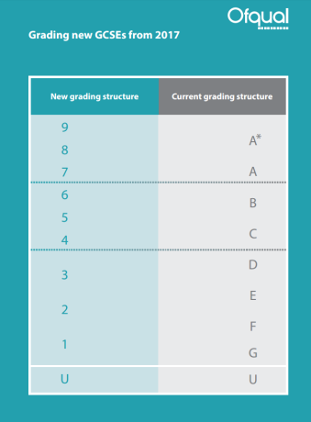
New 9 to 1 GCSE grading structure
In the first year, the
same proportion of students will as previously got A and above
achieve a grade 7 and above
achieve a grade 4 and above as previously got C and above
achieve a grade 1 and above as previously got G and above
Notes:
The new 9 to 1 grading system will mean that it will be clear to employers, colleges or universities whether students have taken the unreformed GCSEs (legacy) or the reformed, more challenging ones.
The new grade scale will not be directly equivalent to the old A*-G one. However, there will be some comparable points between the old grades and the new ones, called ‘anchor points’. In the first year of a new qualification we will ensure that:
Broadly the same proportion of pupils will achieve a grade 7 and above as previously achieved a grade A and above
Broadly the same proportion of pupils will achieve a grade 4 and above as previously achieved a grade C and above
Broadly the same proportion of pupils will achieve a grade 1 and above as previously achieved a grade G and above
Grades 2, 3, 5, 6 and 8 will be evenly spaced between these points.
In the first year of a new qualification the grade 9 will be set using a tailored approach. We have written a blog to explain how this will be done, available here https://ofqual.blog.gov.uk/2017/04/05/setting-grade-9-in-new-gcses/
There is more differentiation in the reformed qualifications, as there are three top grades (7, 8 and 9), compared to two in the unreformed qualifications (A and A*). Fewer students will get a grade 9 than previously got an A*.
Employers, colleges and universities will continue to set their own entry requirements. We have said where employers, colleges or universities previously required a grade C as a minimum requirement, they can expect to require a grade 4 in future, unless they have made a conscious decision to raise the bar.

Slide 7
What grade should you look for?
Your decision……
If you have previously asked for a C or above in English and/or maths the read across would be to a 4 or above
Broadly, the same proportion of students who would have got a C or above will get a 4 or above in these subjects

Slide 8
Why has the grading changed?
To signal a student has taken a reformed GCSE – new content, new assessments
To allow for better differentiation between students, especially at the top and in the middle of the ability range, for example, there will be fewer top grades (grade 9) awarded than there have been A*s.
NB students in Wales and Northern Ireland will mainly take GCSEs that use A*-G grades.

Slide 9
How about AS and A levels – in England?
Fewer changes
New content
AS will be optional – the marks won’t contribute to the A level marks
Still graded A*-E (A-E for AS).
Notes:
Content - Content for the reformed A levels has been revised to better prepare students for university. Changes will vary by subject. Content for all reformed AS and A levels is available here: https://www.gov.uk/government/collections/gce-as-and-a-level-subject-content
An up-to-date list of accredited subjects for first teaching in September 2018 is available here: https://www.gov.uk/government/publications/accreditation-of-gcses-and-a-levels-for-teaching-from-2018/gcse-and-a-level-subjects-accredited-to-be-taught-from-2018
Structure - The reformed A levels will be linear qualifications, with all exams at the end of the two years, to allow more time for teaching. As outlined in slide 12, the AS will no longer count towards the A level, and your school or college may decide to offer the AS in some subjects but not all.
Assessment - The amount of coursework in each subject varies. However, assessment is mainly by examination and coursework or non-exam assessment (NEA) will only be included where skills and knowledge cannot be assessed validly by exams. The requirements for each subject vary and some do not require coursework or NEA but do require students to do practical work. Their learning from the practical work is assessed in exams.
Grading – Grading for A levels will remain unchanged. However, for science A levels, students will also receive a separate pass/fail grade for their practical skills, sometimes referred to as an endorsement.
The awarding process
We have written a blog that explains the awarding process that you might find useful: https://ofqual.blog.gov.uk/2018/01/19/gcse-and-a-level-awarding-in-2018/
As with GCSEs, to ensure that students who are first to take the reformed AS/A levels are not disadvantaged, Ofqual will use a process called ‘comparable outcomes’ to ensure that roughly the same proportion of students achieve similar grades as in previous years, assuming the ability profile of the students remains the same.
We are carrying forward standards from unreformed qualifications to the new reformed AS/A levels. This means that the standard has not changed.
In unreformed A levels grade boundaries are set in different ways. Grades A and E are key grade boundaries and are set by exam boards using evidence including senior examiners’ judgments of student work and statistical predictions. Grades B, C and D are known as arithmetic grade boundaries. They are set by calculating the difference between the marks for A and E and dividing by 3, so that there are equal marks between each grade boundary. To achieve an A* students must achieve an A grade overall and 90% of the UMS marks on the A2 units.
In the new reformed A levels, grades A and E remain key grade boundaries and will be set by exam boards using evidence including senior examiners’ judgments of student work and statistical predictions. However A* will be set using statistics. As now, grades B, C and D are arithmetic grade boundaries and will be set by dividing the difference between the marks for A and E. The approach is very similar to A levels currently.

Slide 10
When do these reforms affect AS and A level students?
Level | Started course in 2015, first A level exams in 2017, first AS level exams in 2016 | Started course in 2016, first A level exams in 2018, first AS level exams in 2017 | Started course in 2017, first A level exams in 2019, first AS level exams in 2018 | Start course in 2018, first A level exams in 2020, no AS level exams available in these subjects
AS and A Level | Art and design, biology, business, chemistry, computer science, economics, English language, English language and literature, English literature, history, physics, psychology, and sociology. | 2015 subjects plus… Dance, drama and theatre, French, geography, German, classical Greek, Latin, music, physical education, religious studies and Spanish. | 2015 and 2016 subjects plus… Accounting, ancient history, Chinese, classical civilisation, design and technology, electronics, environmental science, film studies, maths*, further maths, geology, history of art, Italian, law, maths, media studies, music technology, philosophy, politics, Russian, and statistics. | All previous subjects plus… Arabic, Bengali, biblical Hebrew, Gujarati, modern Greek, modern Hebrew, Japanese, Panjabi, Persian, Portuguese Polish, Turkish, and Urdu.
*A level maths will be available for examination at the end of its first year of teaching. Its first award will be summer 2018
Notes:
What is happening?
AS and A levels are in the process of being reformed, taught and awarded as in the table above.
A lot of subjects including English, the sciences and history A levels have been taught since 2015 with AS exams in 2016 and A level exams in 2017. There will be more reformed qualifications taught to students from September 2017 and 2018.
Some AS and A level subjects have not been reformed and will not be continuing, for example AS and A levels in general studies, creative writing and health and social care. For a full list of these subjects please see here: https://www.gov.uk/government/publications/gcse-as-and-a-level-subjects-that-are-not-being-reformed
The reformed qualifications are part of a number of recent changes to GCSEs, AS and A levels in England that will affect schools in the coming years. The Secretary of State for Education has announced that there are no plans to introduce new GCSEs, AS or A levels in new subjects in this parliament.
Although there is AS level content available for the languages starting in 2018, exam boards have advised us that they do not intend to offer AS qualifications in these languages. There will also be no AS in history of art.

Slide 11
Changes to science

Slide 12
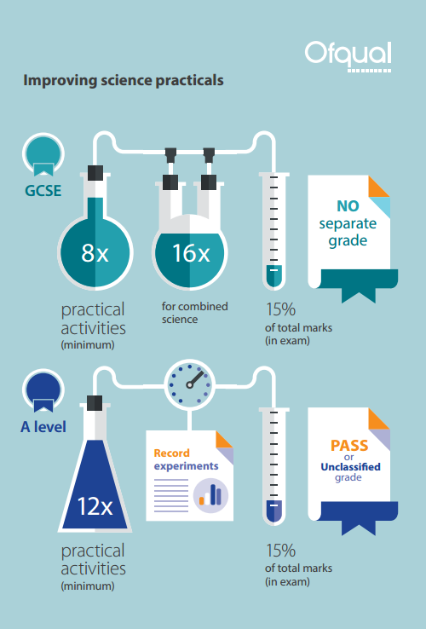
Practical science assessment
GCSE:
There is no separate grade for practical skills
Students studying combined science will receive one of 17 grades from 9-9 (highest) to 1-1 (lowest).
A level:
Students' competence in practicals is reported separately (‘pass’ or ‘not classified’)
Practical ‘pass’ for A level science likely to be required by universities – check admissions information
Notes:
GCSE
In the reformed GCSEs, students will no longer do controlled assessments in science. Instead they will do a broader range of required practicals throughout their GCSE course that will allow them to experience more techniques and apparatus. The Headteacher will be required to confirm that the required practicals have taken place.
Students' understanding of practical techniques will now be assessed as part of the written exam, and their performance in this aspect will be included in their overall grade.
The time that was spent in controlled assessment is now available for science teaching, including practical work.
Schools will be required to provide exam boards with an annual statement confirming that the school has taken reasonable steps to secure opportunities for practical work for their students.
We have included in these slides science as an example of a subject that will be affected by changes to the way practical work is conducted. As it is a core subject at GCSE these changes will affect most students. There are changes to non-exam assessment in other subjects too: subject teachers are best placed to explain these changes to students, with support from their exam board.
A level
Students undertake at least 12 practical activities in order to develop and demonstrate their competency in practical skills.
Students will be responsible for recording their practical work.
Practical work in science is supported by new common practical assessment criteria, that can be found in subject content materials and the specifications published by exam boards.
Students will get a separate ‘pass’ or ‘not classified’ grade for practical skills – reported separately from their main grade.
Schools and colleges are required to provide exam boards with an annual statement confirming that they have taken reasonable steps to secure that students have undertaken at least 12 practical activities, and have made a contemporaneous record of their work.
Exam boards will monitor schools and colleges to check how they provide their students with opportunities to take the practical science assessments and how they assess them.
Visits to schools and colleges already underway; this is a joint operation across exam boards. Visits will take place at least every 2 years so all centres will be visited in the first 2 years of their course.
AS level
As with the A level, students will undertake practical activities to develop their understanding of practical techniques. This will be not be reported separated but will be assessed as part of the written exam, and their performance in this aspect will be included in their overall grade. The written questions about practical work make up at least 15% of the total marks for the qualification.
In May 2018 Ofqual published research into students’ practical skills. More information can be found here: https://www.gov.uk/government/news/a-level-biology-students-show-stronger-practical-skills

Slide 13
GCSE science grading
Students taking separate science GCSEs will get a grade from 9 to 1 for each subject, with 9 being the highest grade.
Students studying combined science will receive an award worth two GCSEs, consisting of two equal or adjacent grades from 9 to 1 e.g. (9-9, 9-8, 8-8, 8-7, 7-7…to 1-1).

Slide 14
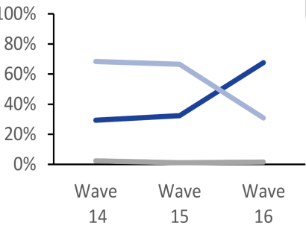
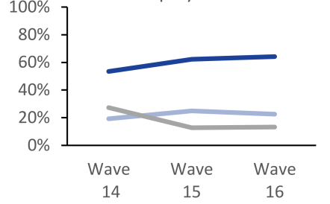
Awareness of GCSE 9 to 1
Employer awareness
Understanding of the top grade
Notes:
Further information about our latest perception survey work is available at: https://www.gov.uk/government/statistics/perceptions-of-a-levels-gcses-and-other-qualifications-wave-16

Slide 15
Ofqual resources

Slide 16
GCSEs 9 - 1

Slide 17
New GCSE grading for science

Slide 18
Visit:
Postcards www.gov.uk/government/publications/your-qualification-our-regulation-gcse-as-and-a-level-reforms
www.ofqual.gov.uk
https://www.facebook.com/GCSEs9to1/
https://ofqual.blog.gov.uk/
Subscribe:
Exam matters: http://bit.ly/exammatterssignup
9 to 1 news http://eepurl.com/cjmK-j
Contact:
Email: public.enquiries@Ofqual.gov.uk
Call Ofqual: 0300 303 3344
Tweet: @Ofqual

Slide 19
Key messages
Key messages are GCSE 9 to 1 in 20 subjects including sciences, geography, history and French, German and Spanish
Second year of GCSE 9 to 1 English Literature, English Language and mathematics (first awarded summer 2017)
For England only
9 is the highest grade
Mix of number/letter grades on certificates for GCSEs – 9 to 1 and A*-G
Ofqual have an active comms campaign - lots of information available
Some changes at A level but not as significant and same grading.

